Slide 1
Global Education
Presentation for McQueen High School
Reno, Nevada

Slide 2
Presentation Overview
What is global education?
How global is Nevada?
What are the four global competencies?
How are the global competencies embedded into our standards?
Where is McQueen High School in terms of global education?
What goals can McQueen High School set to further our global education?
What do our McQueen global studies students say about the global studies program at our school?

Slide 3
What is global education?
Global education emphasizes the unity and interdependence of human society, developing a sense of self and appreciation of cultural diversity, affirmation of social justice and human rights, as well as building peace and actions for a sustainable future in different times and places.
Australian Global Educators , Education Services Australia

Slide 4
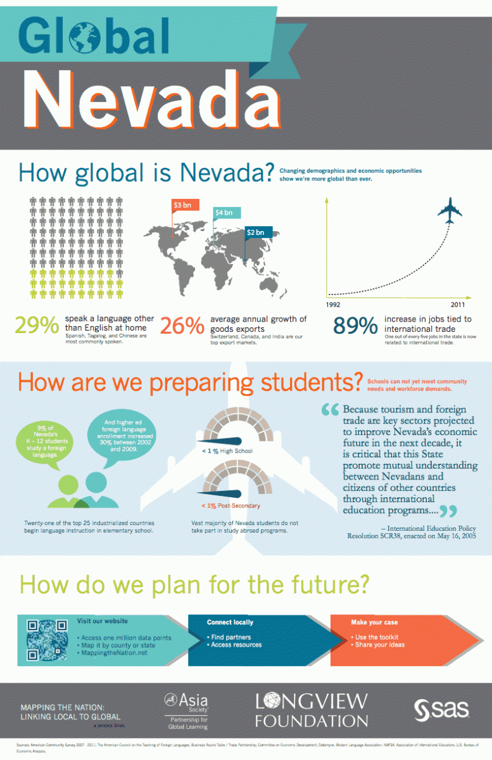

Slide 5
For global education to occur, the four global competencies must be imbedded into the curriculum and standards.
1. Investigate the world: Students investigate beyond their immediate environment
2. Recognize perspectives: Students recognize their own and other perspectives
3. Communicate ideas: Students communicate their ideas effectively with diverse audiences.
4. Take action: Students translate their ideas and findings into appropriate actions to improve conditions.

Slide 6
How are the global competencies embedded into our standards?
Example
WL Standard 4.1: Students demonstrate understanding of the nature of language through comparisons of the language studied and their own.

Slide 7
An
Students will participate in a forum with native Hispanic students to discuss what’s the hardest part of learning English for them and what’s the hardest part of learning Spanish for the other students. (recognizing perspectives)
Students will investigate how the spoken and written Spanish language differs in Argentina, Spain, and Mexico. ( investigating the world)
Students will volunteer at an adult education class in Reno to tutor adults learning English as a second language. ( take action)
Students will present in Spanish to their peers their the results of their investigation mentioned above. ( communicate ideas)

Slide 8
Where is McQueen High School in the global education checklist put out by The American Forum for Global Education? Our strengths:
We have a District Global Studies Signature Academy at McQueen.
Global Studies students are required to present a senior portfolio on a world issue presented in one of the languages they have learned.
Our school offers a variety of languages: Spanish, French, Chinese, and German. Global Studies students must take two languages beyond English.
Our community has a diverse population. One quarter of Nevadans are Hispanic. Our governor is Hispanic. Our school and community celebrate cultural events all year. These lunchtime events are popular at our school. Our general population attends- not just students in World Language classes or in the Global Studies program.

Slide 9
5. Our local university, The University of Reno, has a very forward looking president, Dr. Marc Johnson, who is very visible in the community and has elevated our university to a Tier 1 university.
6. The Northern Nevada International Center operates out of UNR. The TGC program is under its umbrella and it has partnered with our district’s teachers for the past four years. The NNIC sponsors local community events like El Dia de los Muertos. Families in the community hosted students from Algeria and those students came to our classrooms to speak with us about their daily lives in Algeria.
7. We just appointed a World Language District Coordinator for the first time in our district.
8. The State of Nevada just adopted The Seal of Biliteracy. Qualified Seniors will begin receiving it at Graduation.

Slide 10
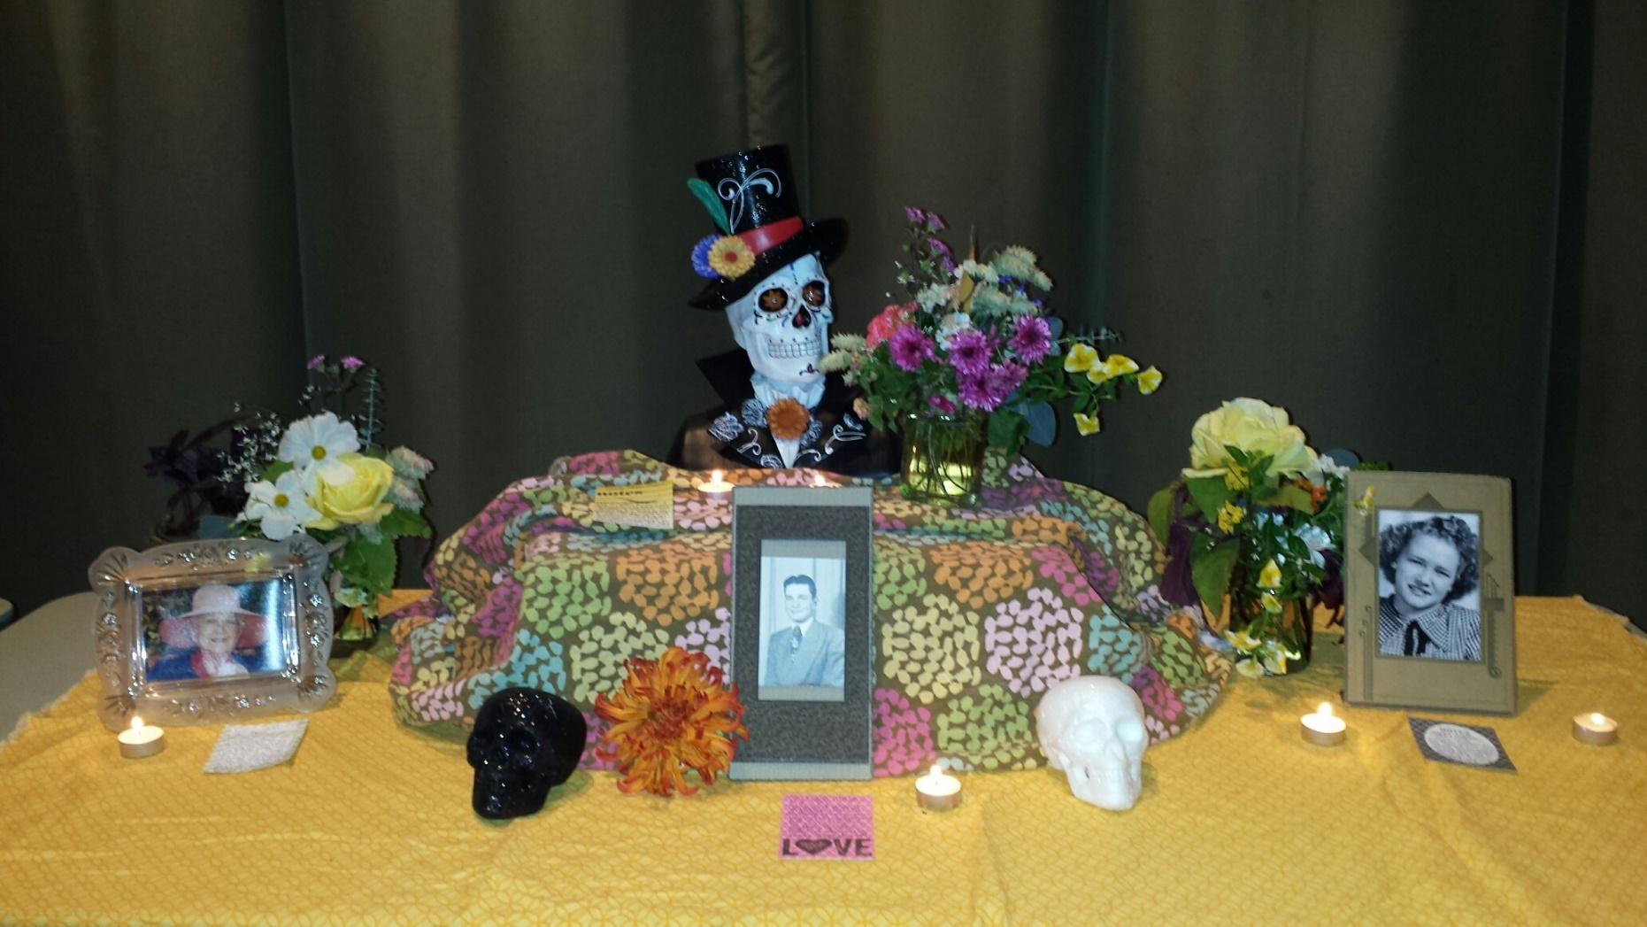
El Dia de los Muertos Celebration at UNR

Slide 11
What can McQueen High School do to further global education?
1. Have a more diverse faculty to reflect our diverse community.
2. Offer global education to all of our students.
3. Have our teachers collaborate and have more multidisciplinary projects’
4. Have more technology in our classrooms- specifically individual technology like laptops or I pads with multiple apps to connect us to the world.

Slide 12
What do Global Studies students say about their program?
The classes that are required for Global Studies have taught me more than just history and geography. They have taught me to be responsible, punctual, and hard working. The program has introduced me to so many friendly and ambitious people that have similar dreams. I have learned to view myself as a global instead of American citizen. I would love to see a language like Arabic available to students because of is rising importance in our world.
Kyler

Slide 13
It has helped me realize that there is more going on than we often see in our daily lives. It has helped me think about the big picture.
Steven
It has helped me express myself in various ways. I’ve also made many new friends and connections that I wouldn’t have if I did not do The Global Studies Program. It has allowed me to branch out.
Shane M.

Slide 14
Since joining The Global Studies Fine Arts Program, I have learned more techniques to use with clay and ceramics. I have also learned more about art’s background, traditional art techniques, and I have developed and improved my art skills. I have grown and learned so much in my art classes and it hasn’t even been a year yet.
Abbey
It has inspired me to continue with my talents involving music and language and led me to unforgettable experiences.
Hannah

Slide 15
The Global Studies Program is rigorous and has given me many challenges. It has made me more future –conscious. It has helped me grow as a person through setting priorities and as a student through perseverance.
Serena
It has made me challenge myself and strive to be better. It has pushed me in a positive way and has set me up for success.
Shane H.

Slide 16
Cultural Projects by my students in 2015
Matrimonio Homosexual en Espana
Las Leyendas

